Slide 1

Project Title - SEASONAL AGRICULTURE PERFORMANCE ANALYSIS
Student Name : Shraddha Dattatray Kharade
College Name : International Institute of Information Technology ,Pune
AICTE STU ID : STU6832ab424991f1748151106

Slide 2

PROBLEM STATEMENT
Agricultural activities are influenced by seasonal variations in environmental conditions, farming practices, resource availability and market conditions. As a result, agricultural performance may differ from one season to another. However, raw agricultural data does not clearly explain how agricultural performance changes across seasons or what patterns can be observed in different seasonal conditions. The problem is to analyze the given agricultural dataset and investigate seasonal differences in agricultural performance by identifying meaningful patterns, trends, relationships and variations within the available data.

Slide 3
Project Description
This project analyzes agricultural data from different seasons to understand variations in production, yield, profitability, resource usage and environmental conditions.
Analysis Approach :
Data Collection → Data Cleaning → EDA → Seasonal Analysis → Statistical Analysis → Visualization
Key Areas
Seasonal performance comparison
Crop-wise performance
Crop × Season interaction
Environmental conditions
Irrigation and water efficiency
Resource utilization
Revenue, cost and profit
Disease/Pest risk
Regional variation

Slide 4

WHO ARE THE END USERS?
Farmers & Farm Owners
    Track crop performance across seasons
    Improve resource and irrigation decisions
    Identify profitable crops and farming practices
Agricultural Departments & Government Agencies
    Understand regional and seasonal agricultural trends
    Support evidence-based agricultural planning
    Identify areas requiring intervention
Agricultural Analysts & Researchers
    Study relationships between environment, resources, yield and profit
    Compare crops, seasons and regions
    Identify trends, anomalies and performance gaps
Agribusiness & Agricultural Planners
    Evaluate crop profitability and market performance
    Support production and resource planning
    Improve decision-making using data-driven insights

Slide 5

Technology Used
Technology / Tool | Purpose in the Project
Python | Data analysis, cleaning, statistical calculations and automation
Pandas & NumPy | Data manipulation, preprocessing and numerical analysis
Matplotlib & Seaborn | Data visualization, charts, plots and heatmaps
Google Collab | Cloud-based environment for writing and executing Python code
Statistical Analysis | Correlation analysis and ANOVA to identify relationships and seasonal differences

Slide 6
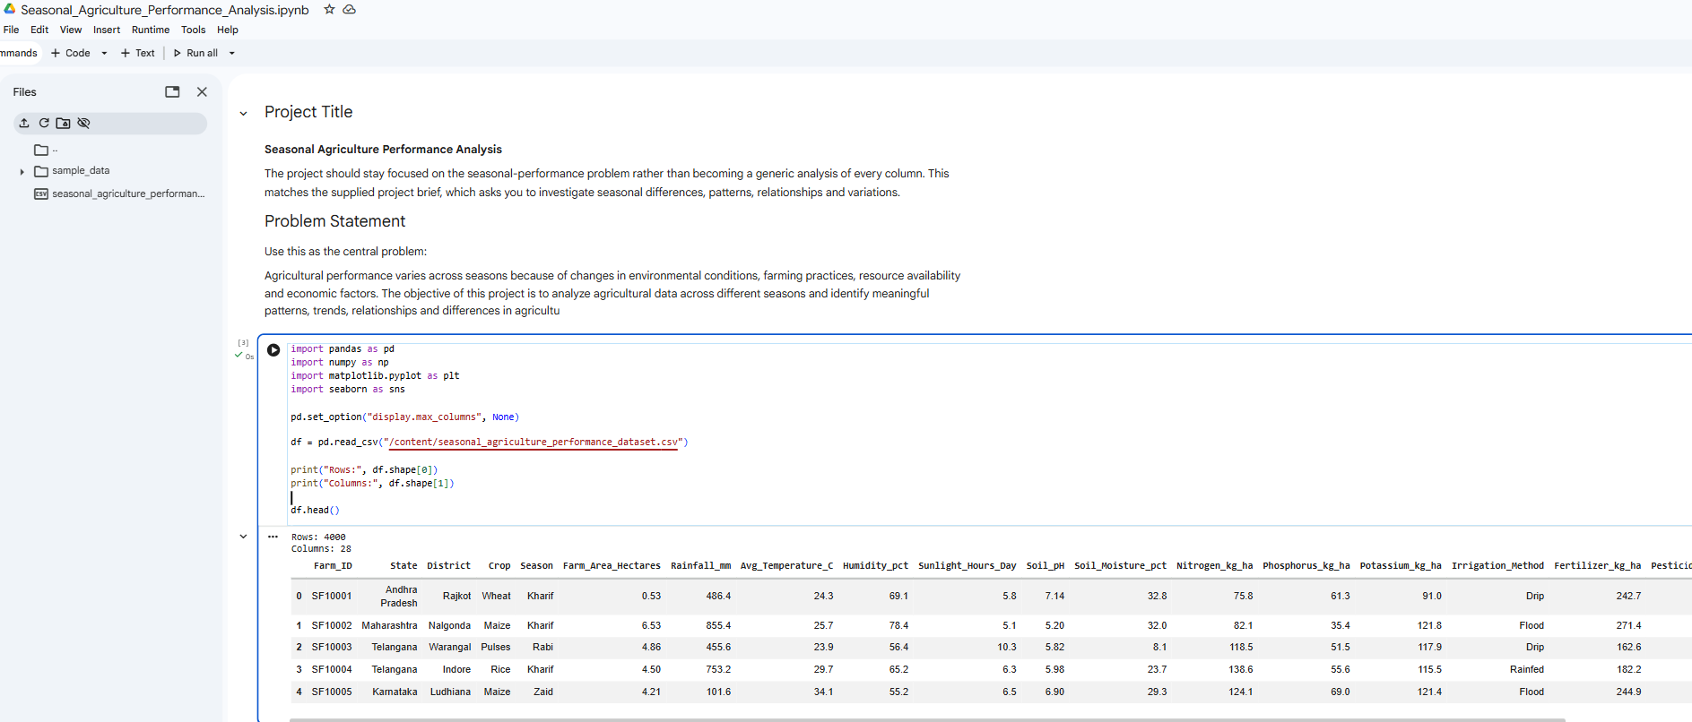
RESULTS

Slide 7
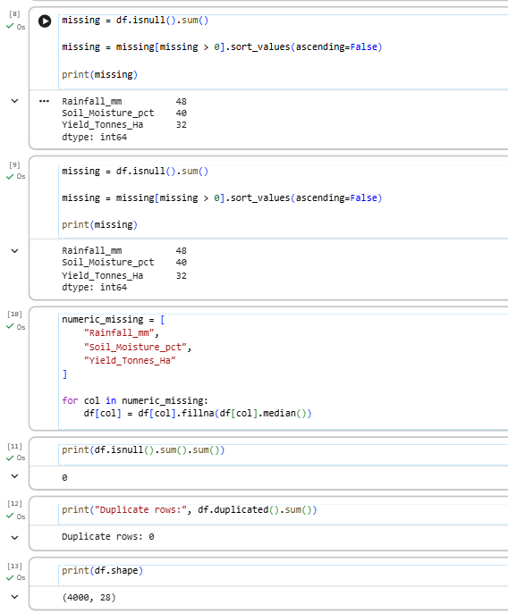
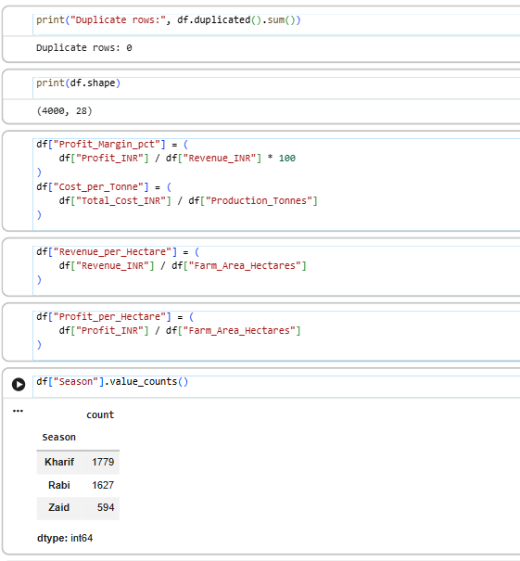
RESULTS

Slide 8
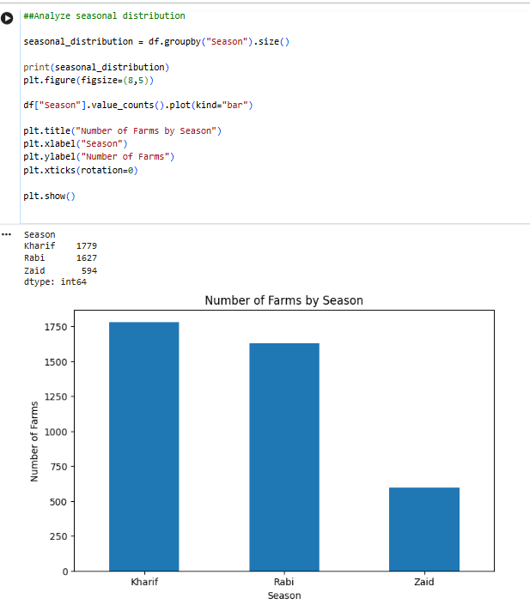
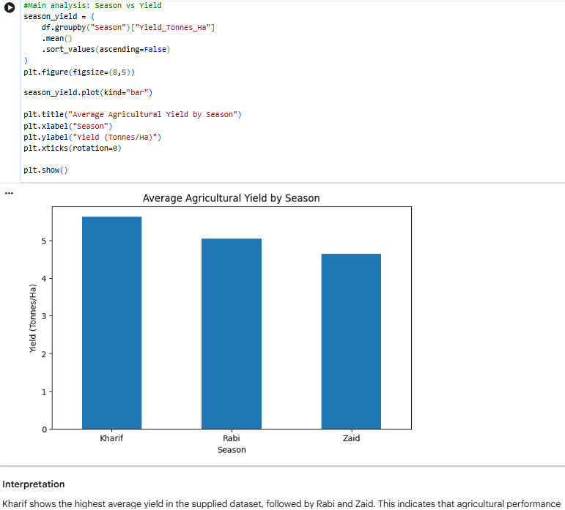
RESULTS

Slide 9
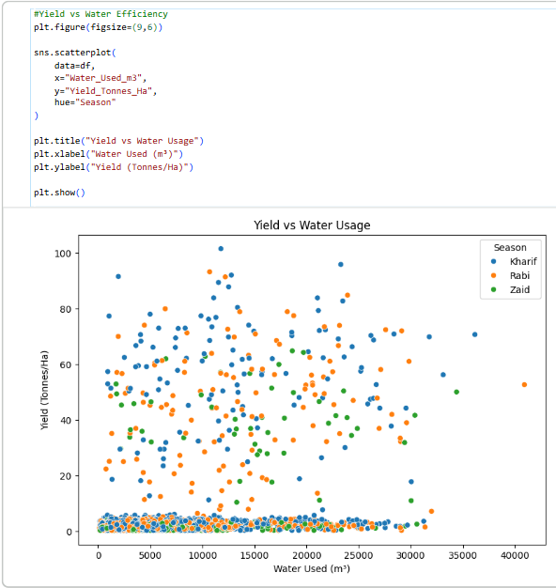
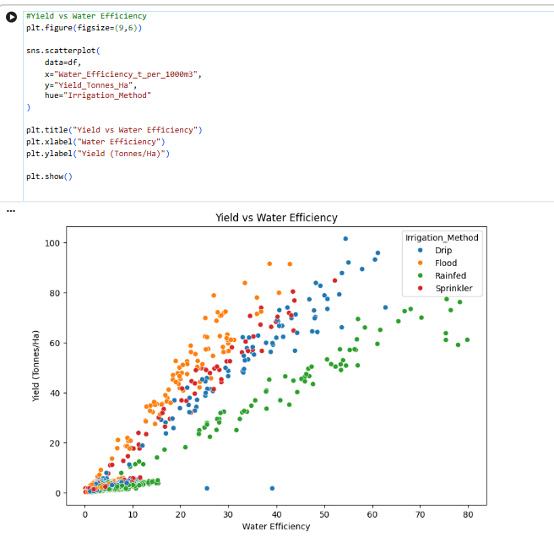
RESULTS

Slide 10
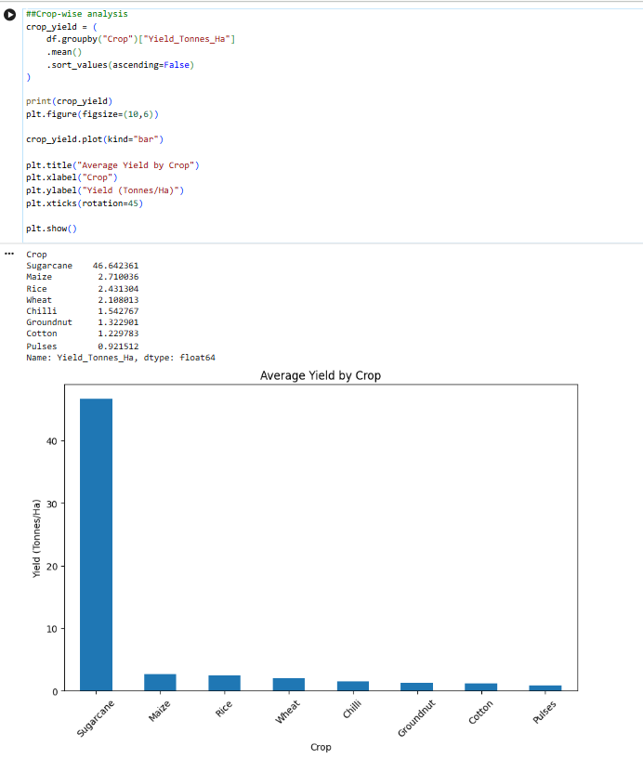
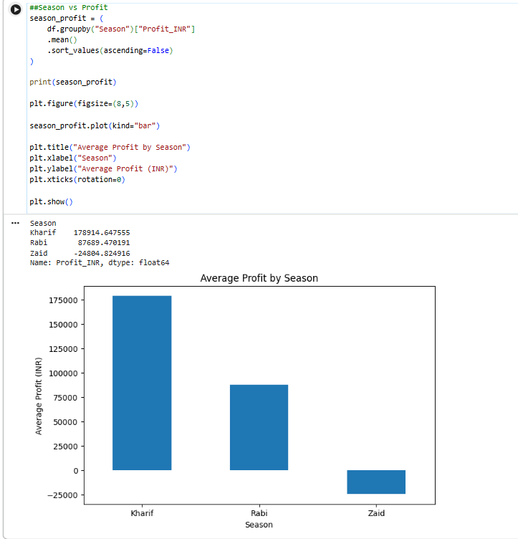
RESULTS

Slide 11
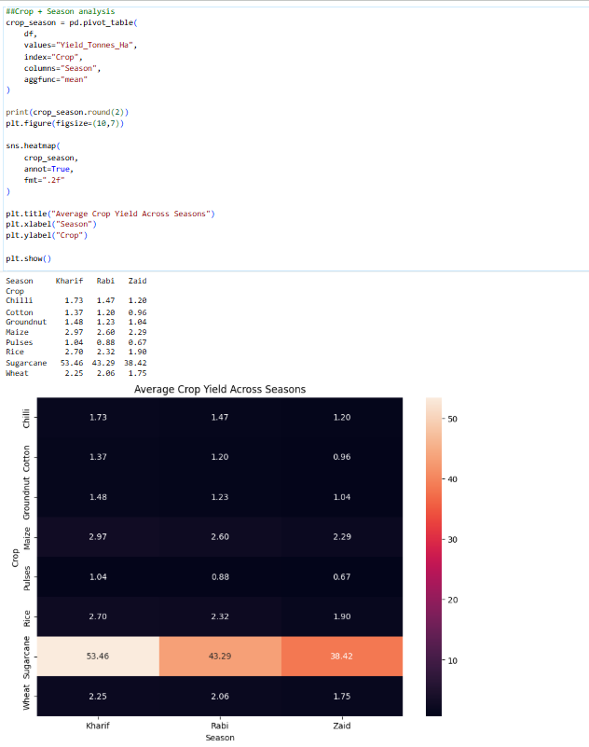
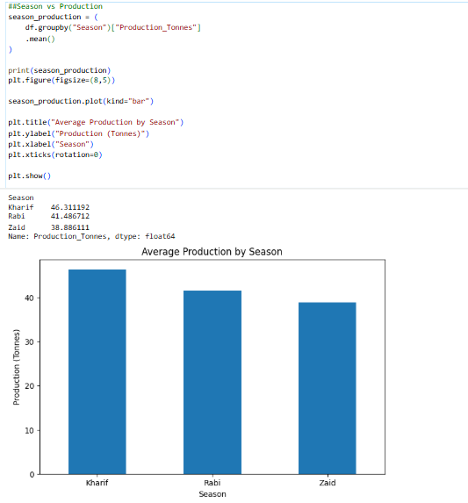
RESULTS

Slide 12
Future scope
The project can be extended using:
Predictive Analytics
  Develop models to predict:
  Crop yield
  Profit
  Seasonal performance
Interactive Dashboard
  Build a Power BI/Tableau dashboard for:
  Season filtering
  State comparison
  Crop comparison
  KPI monitoring
External Data Integration
  Future versions could incorporate:
  Weather data
  Satellite information
  Soil datasets
  Market-price time series
Recommendation System
Develop a system that recommends suitable crop-season strategies based on historical data.

Slide 13
GitHub Link
https://github.com/shraddhakharade126/Seasonal-Agriculture-Performance-Analysis.git

Slide 14
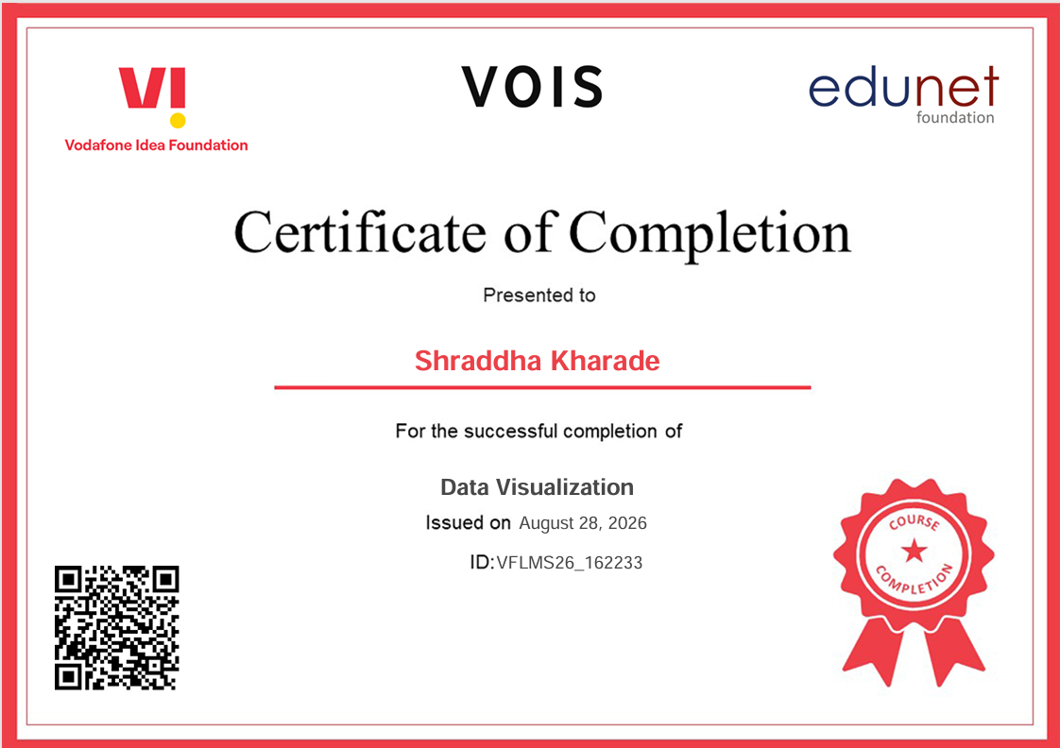
VOIS Course completion certificate -
Course name- Data Visualization

Slide 15
Thank you…
.
.

